Slide 1
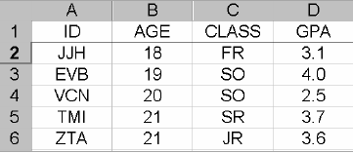
Data and Database
Main Idea
Importance of data
Elements of a database
- Cases, labels, variables, and values
- Categorical and quantitative variables
- Key characteristics of a data set

Slide 2
Data and Database
Importance of data to society and sciences
Standardized tests scores required for “no child left behind” law
Genetic data help identify diseases and cures
Economic data used to measure inflation and set interest rates for home loans
Yield data help agronomists develop better crops
Automobile crash data help engineers design safer cars

Slide 3
Data and Database
2. Database
A database is a way to store and keep track of “raw” data
- Instructors create databases to keep track of grades of their students
Database consists of Cases, labels, variables, and values

Slide 4
Cases, Labels, Variables, and Values
Cases are the objects described by a set of data. Cases may be customers, companies, subjects in a study, units in an experiment, or other objects.
A label is a special variable used in some data sets to distinguish the different cases.
A variable is a special characteristic of a case.
Different cases can have different values of a variable.

Slide 5
Type of Variables: Categorical and Quantitative Variables
A categorical variable places each case into one of several groups, or categories.
--eye color, major area of study, condition of a product (good, defective), etc
A quantitative variable takes numerical values for which arithmetic operations such as adding and averaging make sense.
--height, age, temperature, etc.

Slide 6
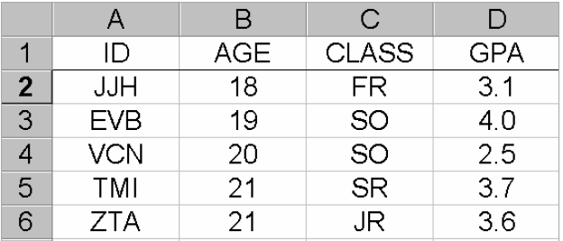
Database

Slide 7
Summarizing the data
To get meaningful results from data, we must summarize the information in a database
Common summary measures:
--Averages: (exam average, average price of gas, average bushels per acre of wheat, average weight loss under a new diet)
--Totals:(total expenditures on books, total enrollments in all KSU colleges, total property damage in a flood)
--Percentages: (percentage of students who get A’s in statistics, percentage of computers that have viruses, percentage of voters who favor increased taxes

Slide 8
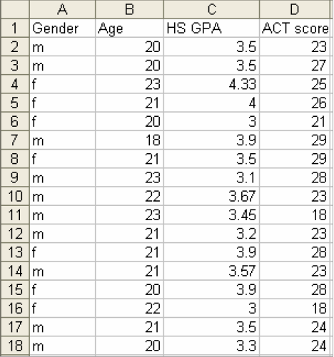
From Raw Data to Meaningful Summaries
Data are gender, age, high school GPA,
and ACT scores of 17 individuals
in a college class

Slide 9
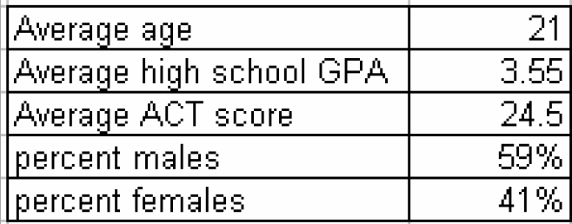
Summary information in table form

